Slide 1
Performance Metrics
By Aymen Tariq

Slide 2
Topics to Cover
Confusion Matrix
Precision
Recall
AUC-ROC

Slide 3
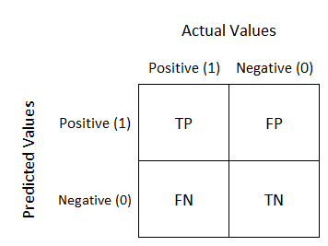
Confusion Matrix
visualizes and summarizes the performance of a classification algorithm
consists of four basic characteristics (numbers) that are used to define the measurement metrics of the classifier
True Positive (TP)
True Negative (TN)
False Positive (FP)
False Negative (FN)
Extremely useful for measuring
Recall
Precision
Specificity
Accuracy
AUC-ROC curves

Slide 4
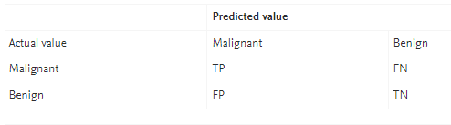
Example Confusion Matrix
TP shows the total patients who have been classified properly to have malignant nodes, meaning they have the disease
TN shows the number of correctly classified patients who are healthy
FP shows the number of misclassified patients with the disease but actually they are healthy. Also called Type I error
FN represents the number of patients misclassified as healthy but actually they are suffering from the disease. Also called Type II error

Slide 5
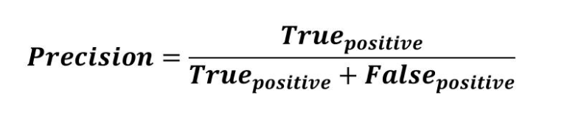
Precision
Measures the accuracy of a model in classifying a sample as positive
The ratio of true positives to total number of positive predictions i.e. TP+FP
Small when incorrect or few positive predictions and vice versa

Slide 6
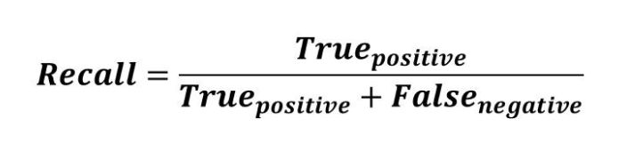
Recall
Measures the ability of the model to detect positive samples
Ratio of True positives to total positive samples i.e. TP + FN
Higher recall, higher number of positive samples detected

Slide 7
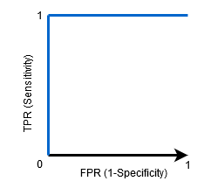
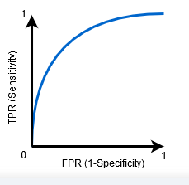
AUC-ROC
AUC is the Area under ROC or receiver operating characteristic
ROC shows the performance of classification model at all thresholds by plotting
True Positive Rate (Recall)
False Positive Rate (FP/ (FP + TN))
AUC Measures how well the model can differentiate between classes
If AUC=1, then correct distinguishment
If AUC=0, the incorrect distinguishment

